Slide 1
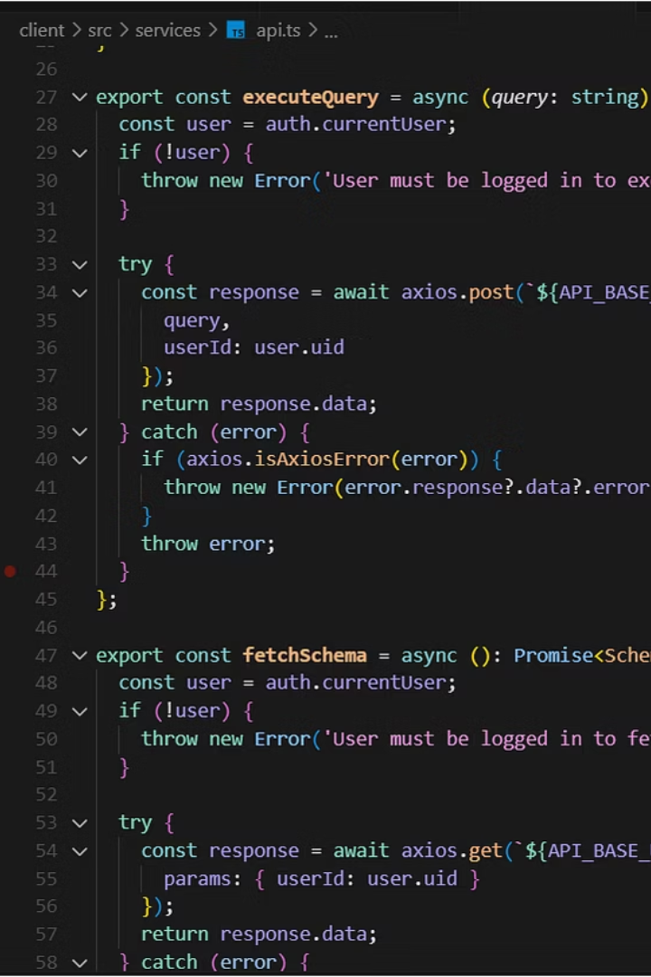

SQL Playground
Interactive Learning Platform for SQL
Solo Developer | React, TypeScript, Firebase
by Harith Yerragolam
TEAM NAME:
CREATE TEAM TEAM_NAME (
name VARCHAR(17),
roll_no VARCHAR(9)
);

Slide 2




Why SQL Playground Matters
Traditional SQL learning
Fragmented tools
Learning, practice, debug
Setup-heavy and boring
SQL Playground
All-in-one browser tool

Slide 3

Learning Experience
Learn by Doing
Structured Challenges
Basic → Advanced
Real-world sets
Progress tracking
Feedback
SQL Playground

Slide 4





Workflow
User Auth
SQL Editor
Run Query
Get Results
Save/Share
Firebase
Monaco
Express + SQLite
Visual Schema
Track Queries
SQL Playground

Slide 5
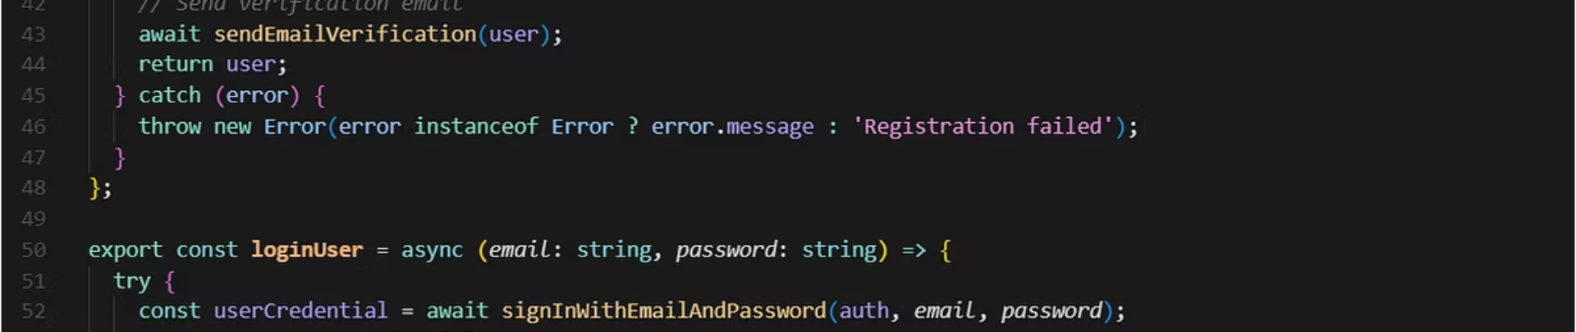




Key Features
Secure Login
Real-time SQL editor
Visual schema viewer
Save/share queries
Firebase Auth
Syntax highlighting
D3.js
SQL Playground

Slide 6
Tech Stack
Frontend
Backend
Auth/Storage
Others
React
Node.js
Firebase
D3.js
TypeScript
Express.js
bcrypt.js
Material-UI
SQLite
Axios
Framer Motion
REST API
SQL Playground

Slide 7





Challenges & Drawbacks
Query Security
Sandboxing query execution
Limited Support
SQLite for now
Performance Issues
Large queries
Multi User Real Time Collaboration
No Live collaboration yet
SQL Playground

Slide 8
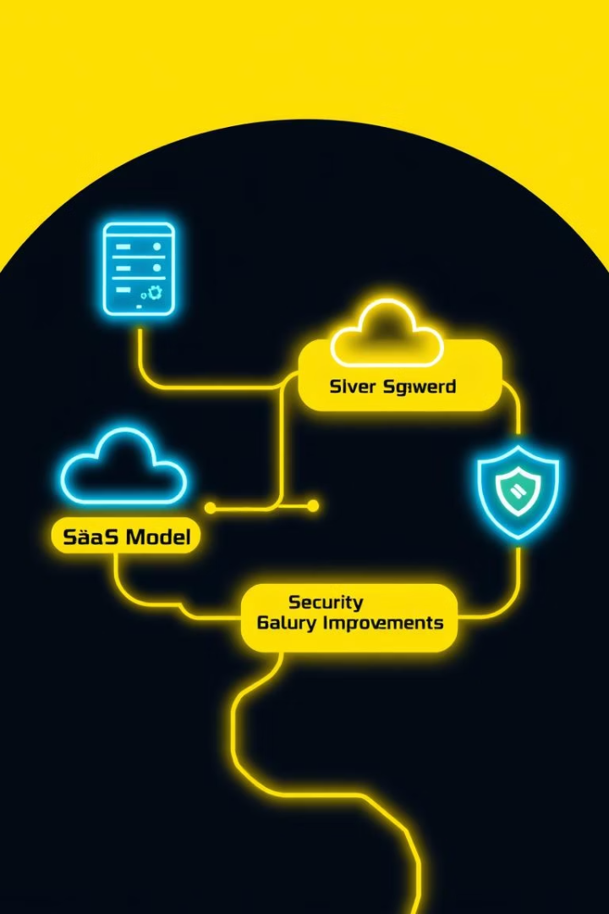
Future Plans
Security improvements
Runtime
Add support
PostgreSQL, MySQL
Educator dashboards
Role-Based Authentication
Implement
SaaS model

Slide 9
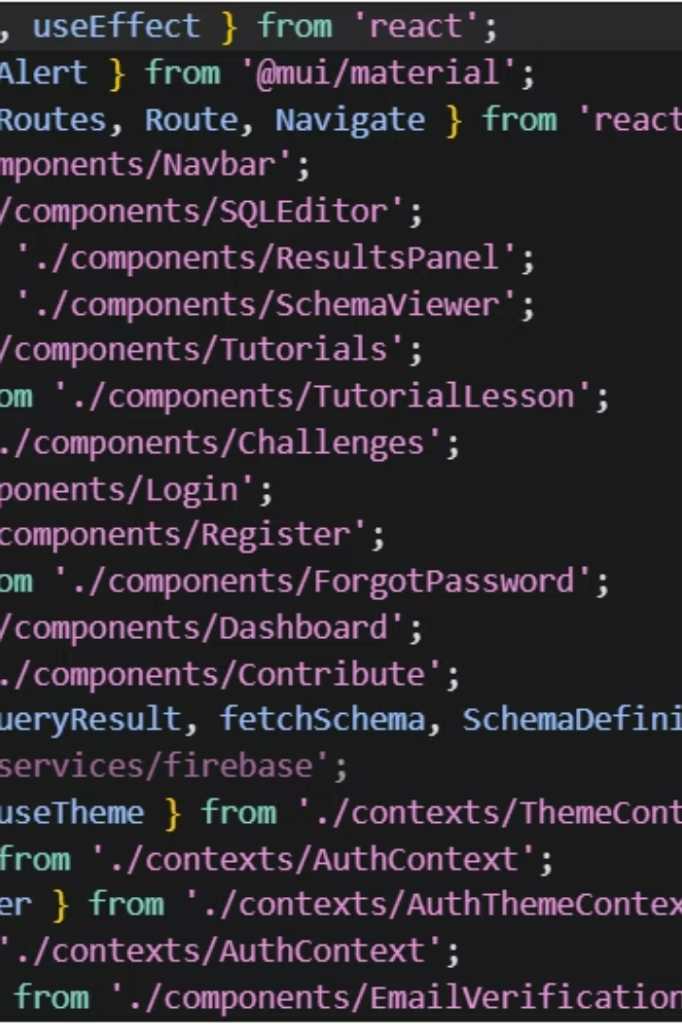
Thank You!
Thanks for listening!
GitHub repo: GitHub
Contact: LinkedIn

